Slide 1
Business, Marketing, Entrepreneurship, Digital Marketing, and Econ Mrs. Schafer

Slide 2
SWOT Analysis
SWOT Analysis Groups
Factors of Production
Precepts

Slide 3

SWOT Analysis

Slide 4
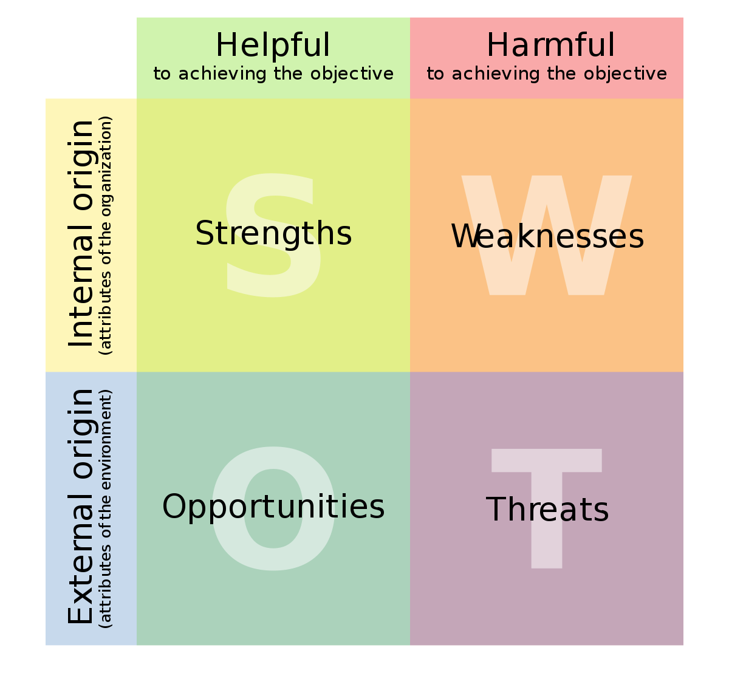
SWOT Analysis

Slide 5
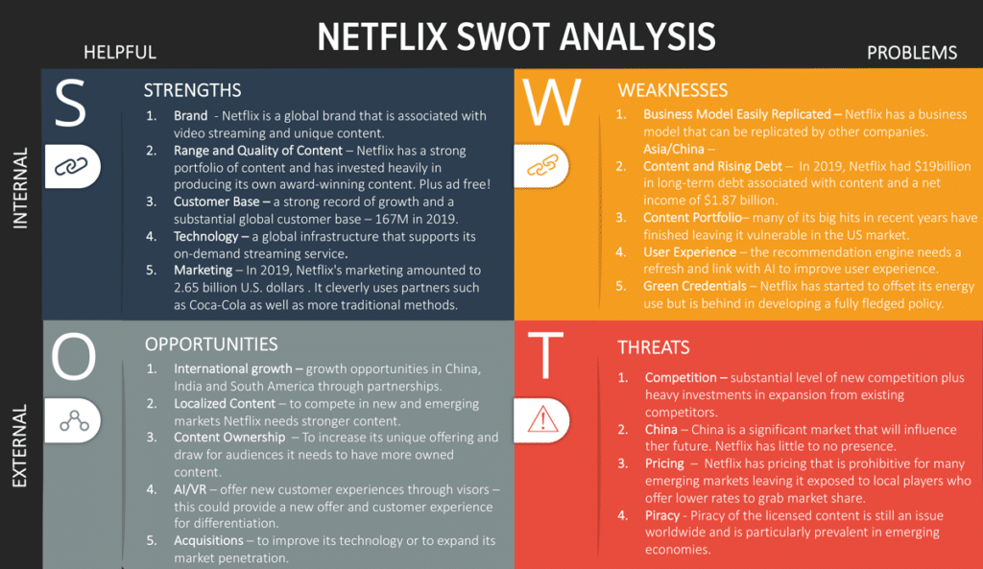

Slide 6
SWOT Analysis – Group Project #1
Contact a small business or non-profit, telling them who you are and offering to do a SWOT analysis for their organization in exchange for a couple hours of their time. Make sure they agree to come to class either in person or virtually to hear your presentation at the end of this quarter
Develop interview questions to ask their POC to gain insight into the internal components of the SWOT (SW)
Conduct research on external factors (OT)
Create the SWOT for that organization
Present the SWOT analysis to the company POC in class
Date | What’s Due
Assigned week of 9/22 | N/A
Review w/Schafer | What company/nonprofit (already contacted and have confirmation that you can work with them)
Review w/Schafer | Internal Interview Questions
Review w/Schafer | Draft of Presentation
Near end of Q1 | Presentation in Class with the business POC there to hear it

Slide 7
Internal (Strengths & Weaknesses)

Slide 8
PRIMO-F (developed by Durham University School of Business)
Uses the following questions to examine the Internal Elements of the company:
People – How good are your staff? Experienced? Leadership?
Resources – What assets does your company have? What could they?
Innovation/Ideas – Patents/Copyrights/Creativity
Marketing – Examine all elements of current Marketing
Operations – Deliver on time? Efficiency? Technical capabilities?
Finance – Available cash? Profit margins? Facilities costs?

Slide 9
External (Opportunities and Threats)

Slide 10
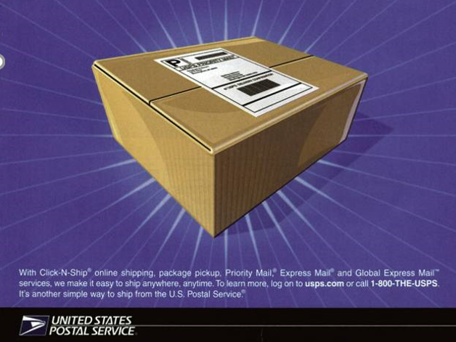
External Opportunities and Threats
Businesses must always look for opportunities to create competitive advantage if they are to succeed in the marketplace.
Shipping
Price Match
Customer Experience

Slide 11
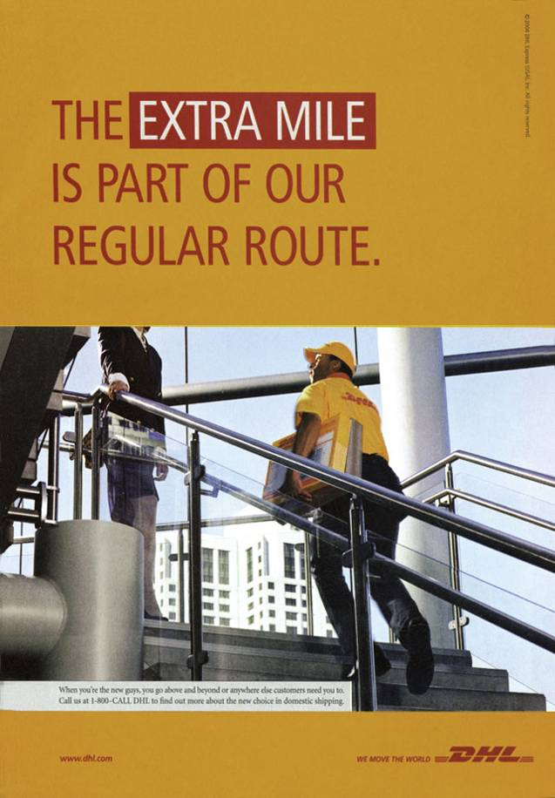
Competition
Changes in competing companies’ financial situations affect the marketplace. Conducting a SWOT analysis helps a business react and adjust to these shifts.

Slide 12

Environmental Scan An analysis of outside influences that may have an impact on an organization
A business may conduct an environmental scan to methodically examine six main areas of the marketplace. The acronym PESTLE refers to these four factors:
Political
Economic
Social
Technological
Legal
Environmental
ALWAYS BE GRINDING

Slide 13

Political
Political issues center around government involvement in business operations, such as:
Laws
Regulations

Slide 14
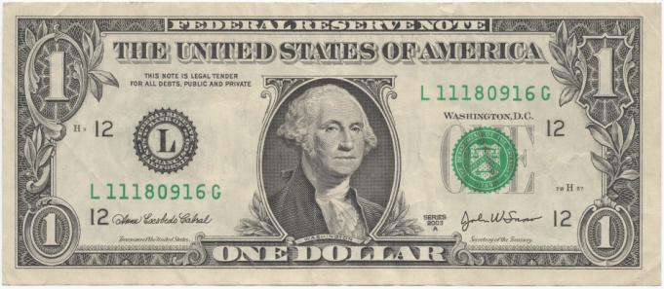
Economic
Businesses are always interested in the economy, which is affected by factors such as:
Unemployment rate
Inflation
Retail sales figures
Productivity

Slide 15

Social
A socio-cultural analysis is based on customers and potential customers. It focuses on their:
Attitudes
Lifestyles
Opinions
Social cultural analysis also considers:
Age
Income
Occupation
Education level
Marital status

Slide 16

Technological
Changing technology may be a threat for one industry, but an opportunity for others. Companies develop new products or capitalize on new developments by making products to support them.

Slide 17

Legal
Companies must ensure that they are operating within the bounds of the law or face serious consequences. However, this typically refers to health & safety standards, equal opportunity laws, and following consumer rights policies.

Slide 18

Environmental
These issues have become more relevant of late. How do you handle pollution? Are you working on sustainable energy? Can you limit your carbon footprint? All companies consider these issues.

Slide 19
Assign groups for SWOT ANalysis
Remember to use your network to find small business or non-profit

Slide 20




Factors of Production
The resources people use to produce goods and services. Economists divide the factors of production into four categories:
Land | Labor | Capital | Entrepreneurship
Physical place where economic activity happens Natural resources found on it: timber, water, oil, livestock | People that are available to transform resources into goods or services | Money and equipment needed to set up or buy resources | The zeal to start things going The idea

Slide 21
Factors of Production Activity
Sammy Wammy is a food scientist based in New York who is on a mission to produce the most succulent S'mores the world has ever tasted. Below is a summary of her story.
When passing by in front of a food truck near Central Park, she suddenly got an idea: Is there anything better than a perfect S'mores while walking through central park in the evening? The next day, a company was incorporated, and her dream, Sammy S'mores, was underway.
Sammy hired 3 food scientists with the objectives of making the perfect S'mores. Everything was tested, from the density of the marshmallows to the crunch of the graham crackers.
Once the perfect recipe was found (about 1 month later), Sammy bought a food truck customized with all the necessary appliances required to make these perfect S'mores on the go.
Sammy paid for a city license to have access to parking space C4 near the park, which would serve as the location for her food truck.
Sammy spent $10,000 buying necessary goods (e.g., branded napkins, uniforms, etc.).
Sammy hired 2 college students to prepare and serve the S'mores in the food truck.
The summary above refers to many examples of the factors of production. Identify as many as you can and categorize them as being either land, labor, capital, or entrepreneurship (Hint: There is at least one example of each!)
Notes:
Land#4
Labor#2, #6
Capital#3, #5
Entrepreneurship#1

Slide 22
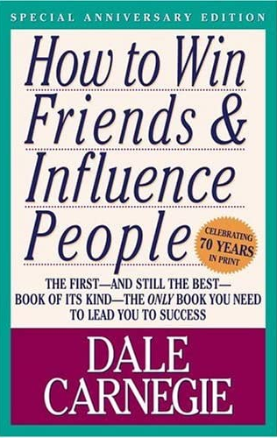
Extra Credit Opportunity: Dale Carnegie
Turn in anytime till end of school year
When you turn it in, it counts toward that quarter’s grade
Worth 5 pts toward your participation grade
Assignment:
Read Dale Carnegie’s book: How to Win Friends and Influence People
Send me via email a paragraph on:
What did you personally learn from the book that you’d do going forward?

Slide 23

Precepts
A precept is like a motto or a famous quote. Any saying or ground rule that can motivate you. Basically anything that help guide us when making decisions about important things.
Take the exact precepts from Wonder and put them into a business context
September’s Precept
When given the choice between being right or being kind, choose kind.
-Dr. Wayne Dyer, American self-help author and motivational speaker
Notes:
Who has read the book Wonder by R.J. Palacio?
Each month we’re going to review the precept that the teacher in that book shared with his class. But we’re going to analyze the meaning of that precept from a business perspective.
At the end of the year after we’ve looked at 10 precepts, one each month, then you will graduate and be off to your adult life. You can email me over the summer or anytime throughout the rest of your life and write your own precept.
Write what you think that precept means in regards to business

